Slide 1

LastPass Password Management
Presented by:
Russell Greenwald, Vice President,
Director of Technology Consulting Practice
January 2016
Copyright © 2016 Insource Services, Inc. All Rights Reserved.

Slide 2
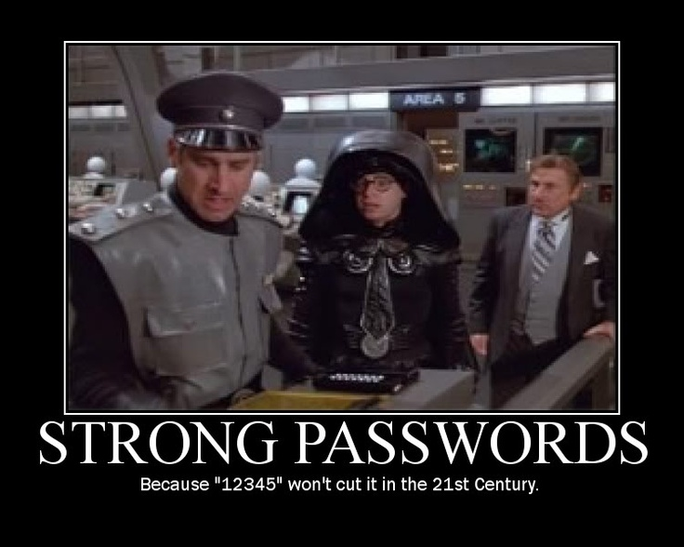
Objectives
Give you tools and information to:
Know what a good password looks like.
Password best practices
Understand what LastPass offers

Slide 3
Poll
Poll Question
Do you keep passwords on a post-it note?

Slide 4
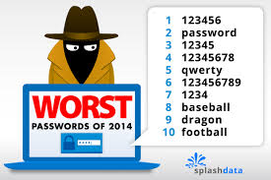
Types of Weak Passwords
Based on common dictionary words (including dictionary words that have been altered)
Based on common names
Based on user/account identifier
Short (under 8 characters)
Based on keyboard patterns 1qa2ws
Difficult to remember

Slide 5
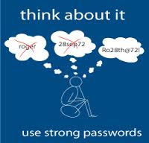
Types of Strong Passwords
Minimum 8 characters
Do not contain a complete word
Contain at least one of: digit, letter, and punctuation
Based on a verse or phrase meaningful to you
Randomly generated and stored in a vault

Slide 6
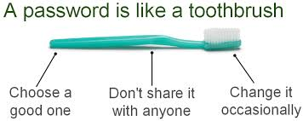
Password Best Practices
Never recycled
Never recorded unencrypted
Different password for every system
Passwords change frequently
Multifactor authentication when available

Slide 7

What is multifactor?
When more than one method of authentication is required to verify login.
  i.e. text messages, Google authenticator, key fob.

Slide 8

LastPass
Secure password manager
One master password with access to vault
Securely share website credentials
Strong encryption

Slide 9
LastPass Demo

Slide 10
Questions

Slide 11
Contact Information
Russell Greenwald, Vice President,
Director of Technology Consulting Practice
rgreenwald@insourceservices.com
781-374-5116
www.insourceservices.com

Slide 12
Please join our mailing list to receive our newsletters and updates!
Text INSOURCESERVICES
to 22828

